Slide 1
NYU Cogeneration and Microgrid John Bradley ITP Spring2016

Slide 2
Superstorm Sandy – A Picture is worth $125 Million

Slide 3
BACKGROUND
COMMUNITY
53,000 students
16,000 faculty and staff
SPACE
14 million square feet in over 135 buildings
Clock started in 2006
Decision to replace Co-generation Plant
Purchase of Renewable Energy Credits (wind power)
Environmental Studies Major launched
Sustainability Task Force created
Green Grants
$275,000 distributed over the first two years to 39 projects
Noteworthy projects: bike salvage; bike share; green roof safety study
Wide Range of Programs and Events
Sustainability Advocates
Residence Hall Competitions and Donation Drives
Food/Dining Hall Changes

Slide 4
Strategy To Reach 50% by 2017
BUILDING BASED
Reduce Demand
Reduce consumption
Increase Efficiency
Behavior Change
Solar PV Installation
LL 87 Audits & Retrofits
CAMPUS WIDE
Improved Lighting & BMS Strategies
Update NYU Design Guidelines
Data Center Efficiency
Laboratory Best Practices
2MW Solar Power Purchase Agreement
ENERGY FUND REVENUE SOURCES
GRT Refunds
Demand Response Funds
NYSERDA Incentive Funds
Cogen Electric Export
Recharge New York (NYPA)
Reinvestment of Energy Savings

Slide 5
Participation in the NYISO Capacity Market

Slide 6
Energy Compared to NYC Peers

Slide 7
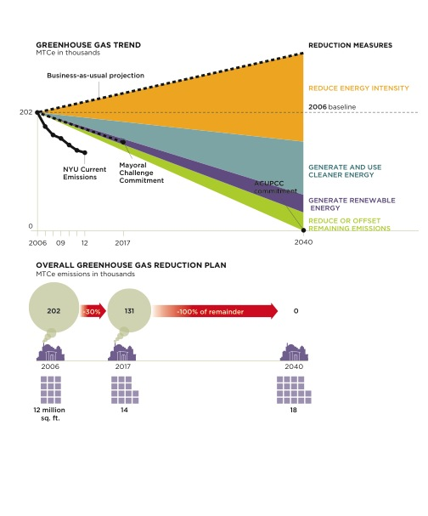
Managing Greenhouse Gas Emissions
MTCe = Metric Tons of Carbon Equivalent
Notes:
Budget number reflects both FCM Managed and FCM Involved budgets ($49.2 FCM, $3.7 FCM Involved);

Slide 8
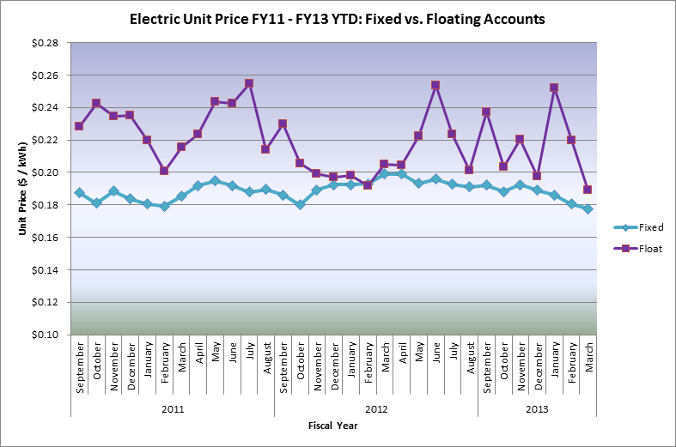
Fixed price energy contracts shield NYU from market volatility

Slide 9
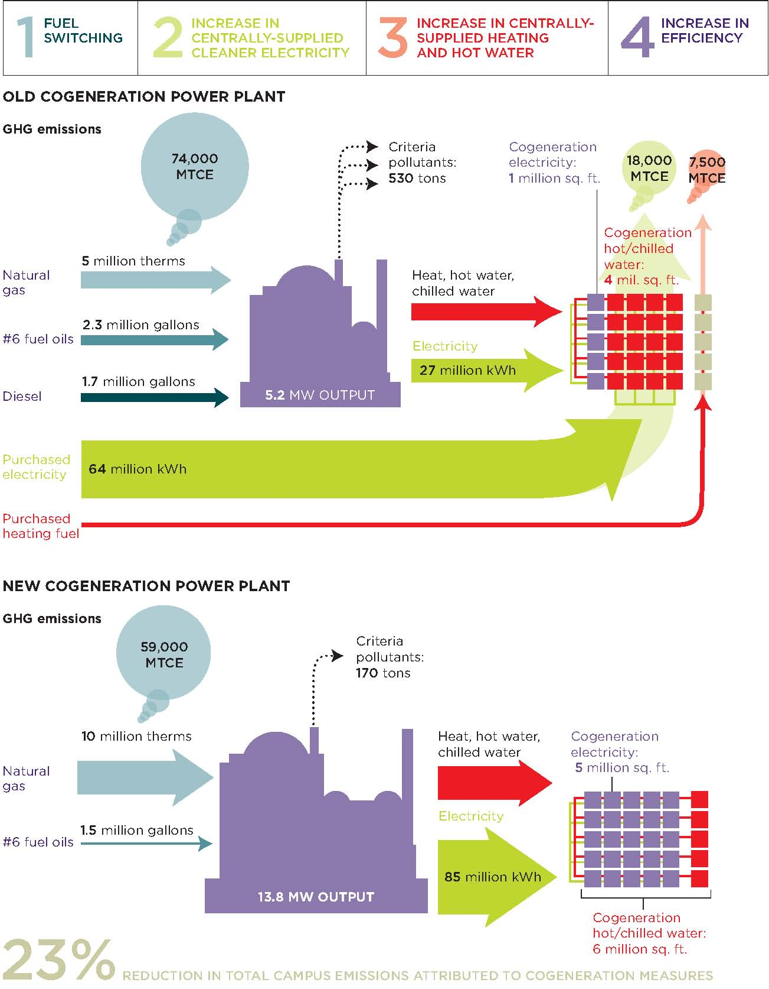
Benefits of New CoGeneration Plant
MTCe = Metric Tons of Carbon Equivalent
Notes:
Budget number reflects both FCM Managed and FCM Involved budgets ($49.2 FCM, $3.7 FCM Involved);

Slide 10
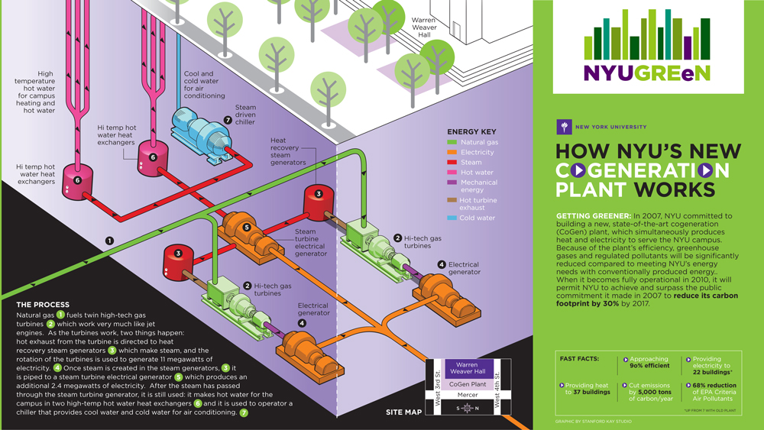
CoGen Operations: State of the Art Technology
Notes:
Budget number reflects both FCM Managed and FCM Involved budgets ($49.2 FCM, $3.7 FCM Involved);

Slide 11
Cogen Plant Vault Under Construction

Slide 12
Gas Turbine Being Lifted into Place

Slide 13
Microgrid Benefits
Community was given access to daily shelter, use of restrooms and heated spaces in Bobst Library
Community was given access to charging stations daily
Students and Faculty in NYU housing were fed at two dining facilities keep open during the entire week long crisis
Cogen power was extended to temporary shower facilities in the Coles Gym building for use by faculty and students
NYU Crisis Command Center in Cogen - Powered Building maintained communication with police, fire and OEM agencies as well as students and parents
City Agencies utilized Cogen – Powered building as Command Centers
Center of Refuge for Students from other areas outside Micro Grid was established in Kimmel Hall and in other powered dorms

Slide 14
Sequence of the ConEd Grid Fail and Microgrid Ops
ConEdison starting losing Voltage in several of the six(6) high Tension feeders that serve the Plant
The Micro Grid monitoring system looking back at the utility detected voltage differential between NYU’s Micro Grid and ConEdison
The Systems relays on feeders automatically opened all six connection between ConEdison and NYU
NYU’s Micro Grid signaled generators and operators that the system had switched to Island control
These controls typical in interconnections between Micro Grids and the Utility performed and designed
The Plant Operators now had a greater challenge - Make sure all the Equipment stayed on line.
This involved a more delicate balance of thermal and electrical loads now the Utility was not there to back up these Micro Grid Generators.
The operators and equipment performed flawlessly through the entire Black Out.
After ConEdison was reestablished NYU seamlessly reconnected without destruction to any of the buildings in the Micro Grid.

Slide 15
Lessons Learned
Resiliency Done in a Sustainable Way
Resiliency Outlook to new construction, renovations and retrofits
48 hour LED emergency lighting
Add critical buildings to cogen microgrid enabled by conservation measures
Enhanced building curtailment plans and load shedding
Microturbines
Commitment to distributed generation - Cogen Phase 2 – providing utilities to an additional 1 million sf in the south campus
“Shelter in Place” strategy to provide emergency power to student and faculty housing
Emergency Fuel Strategy

